Slide 1

Azure DataBricks

Slide 2
Introduction
Software Product - Azure Databricks
Main features
Microsoft Azure product
Cloud-based platform – for international use
Scalable – as the business grows from 30 to 100 employees in the next couple of years
Machine learning – to support the IT team
Data Collection - Gather all your data in one place
Data Cleaning - Databricks helps you clean and standardise the data from the forms
Analysis - Support the IT team with their predictions

Slide 3
Strengths and Weaknesses
Strengths
Databricks has the best of both worlds — a data warehouse and a data lake. Great for small start up then easily scaled
It works with structured and unstructured data, supports various workloads from Data Scientist, Engineer, Data Analyst or Machine Learning Engineer
Maintains a unified knowledge base, where users can search for answers or solutions regardless of their cloud provider
No upfront costs - pay as you go
In-build security features and compliance standards, reducing the burden of managing security and ensuring adherence to industry regulations
Creates a secure, private, compliant, and isolated analytics workspace across users and datasets to protect data
Interactive Workspaces - Enables seamless collaboration between Engineers, Analysts, and Data Scientists.
Weaknesses
Versioning Tool Integration - Azure Data bricks does not integrate with Git or any other versioning tool at the moment but works with Python.
Limited control over infrastructure - Azure Databricks is a managed service and hence user has little control over its infrastructure.
Costs - may be expensive when dealing with large-scale data processing or compute-intensive workloads.

Slide 4
Market Landscape
Competitors
Migration considerations
Snowflake: Simple. More geared towards storage and warehousing
Big Query: Serverless warehouse, excellent for query speed
Best choice depends on specific requirements. Databricks is more an end-to-end solution whereas the others are tailored more specifically to warehousing
Lakehouse technology. Safe space for smaller companies to grow from
Increased focus on AI in production and Databricks provides tools for the whole machine learning life-cycle
Preparation work moving data from Excel to cloud
One-time or incremental, testing and validation
What features are going to be used. Machine learning?
Do we want a hybrid solution. Snowflake for warehouse and Databricks for processing?

Slide 5
Simplicity vs Functionality
Setup
Maintenance
Future Opportunities
Complex. Will have to prepare existing data and make more decisions
Pay-as-you-go. Cost is more complex to track but also provides a more tailored approach
Higher skill set to use/maintain
More BI tools included for future projects
Big data processing opportunities as the company grows

Slide 6
Core Features and Functionalities
Collaboration Tools
Integration with Services
Security
Azure Databricks offers collaborative notebooks that support interactive workflows and real-time collaboration. Data scientists and engineers can work together using notebooks that support Python, SQL, and other languages
Seamless integration with other Azure services like Azure Data Lake, Azure Blob Storage, Azure Synapse Analytics, and Azure Machine Learning enhances the flexibility and extensibility of Databricks workflows
Provides enterprise-grade security with Azure Active Directory integration, role-based access control (RBAC), and fine-grained data permissions, ensuring data and workflows remain secure

Slide 7
Target Market and User Base
Flexible Scaling
Business Analysts
Data Engineering Teams
Databricks is great for growing companies requiring scalable and high-performance analytics and machine learning solutions
Use Databricks to extract insights and visualize data to drive business decisions.
Responsible for creating and maintaining large-scale data pipelines, enabling data access and transformation for analytics

Slide 8
Business Model and Revenue Generation
Scalability: As the customer’s usage of cloud services grows, Azure Databricks scales with the customer.
Pay-As-You-Go: This flexible pricing structure allows growing companies of all sizes to start small and scale as their needs grow, making the platform accessible to a wide range of customers.

Slide 9
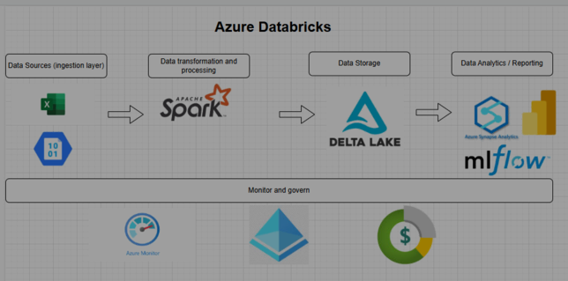

Slide 10
AGILE PLAN

Slide 11
Expansion Projects
Marketing
Tours
Customer segmentation –based on customer attributes to tailor marketing
Marketing Performance – analyse by integrating data from social media, email marketing and website analytics
Marketing effectiveness – if advertising online, can look at click-through rates
Churn risk –analyse behaviour and detect early signs of churn to develop retention strategies
Predictive analytics – predict customer behaviours and preferences to anticipate future trends and develop attractive tours
Online booking system – to streamline reservations and make it more convenient for the customer
Mobile App - to provide customers with easy access to tour information, bookings and real-time updates - improve customer engagement and satisfaction

Slide 12
Conclusion
Azure Databricks offers a comprehensive and flexible platform ideal for small start-ups looking to enhance their data analytics and machine learning capabilities.
All-Round Package - unified environment for data engineering, data science and machine learning. Can handle everything from data ingestion and cleaning to advanced analytics and model deployment in one place
Great for small start-ups - designed to be user-friendly and scalable Don't need extensive infrastructure or large teams to get started Collaborative features also make it easy for small teams to work together efficiently
Flexible - supports various data sources and integrates seamlessly with other Azure services
Worth the investment - can lead to significant improvements in your data processing and analytics capabilities Gain valuable insights, optimise marketing efforts and make data-driven decisions that drive growth

Slide 13

Thank you

